Slide 1
LAB-1
​Prepare cross-wired cable and straight through cable.
​Module Objective: Explain how physical layer protocols, services, and network media support communications across data networks.​

Slide 2
Purpose of the Physical Layer​ The Physical Connection​
Before any network communications can occur, a physical connection to a local network must be established.
This connection could be wired or wireless, depending on the setup of the network.
This generally applies whether you are considering a corporate office or a home.
A Network Interface Card (NIC) connects a device to the network.
Some devices may have just one NIC, while others may have multiple NICs (Wired and/or Wireless, for example).
Not all physical connections offer the same level of performance.

Slide 3
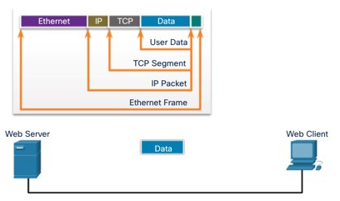
Purpose of the Physical Layer The Physical Layer
Transport bits across the network media
Accepts a complete frame from the Data Link Layer and encodes it as a series of signals that are transmitted to the local media.
This is the last step in the encapsulation process.
The next device in the path to the destination receives the bits and re-encapsulates the frame, then decides what to do with it.

Slide 4
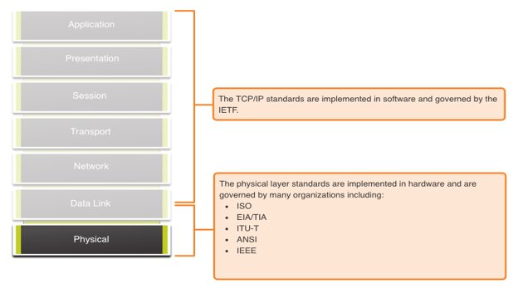
Physical Layer Characteristics Physical Layer Standards

Slide 5
Physical Layer Characteristics Physical Components
Physical Layer Standards address three functional areas:
Physical Components
Encoding
Signaling
The Physical Components are the hardware devices, media, and other connectors that transmit the signals that represent the bits.
Hardware components like NICs, interfaces and connectors, cable materials, and cable designs are all specified in standards associated with the physical layer.

Slide 6
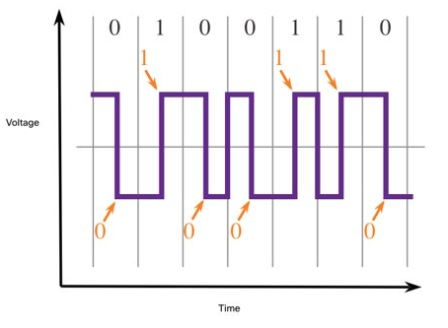
Physical Layer Characteristics Encoding
Encoding converts the stream of bits into a format recognizable by the next device in the network path.
This ‘coding’ provides predictable patterns that can be recognized by the next device.
Examples of encoding methods include Manchester (shown in the figure), 4B/5B, and 8B/10B.

Slide 7
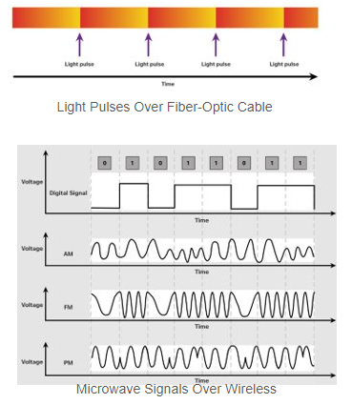
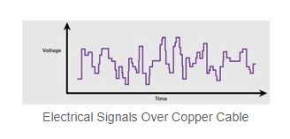
Physical Layer Characteristics Signaling
The signaling method is how the bit values, “1” and “0” are represented on the physical medium.
The method of signaling will vary based on the type of medium being used.

Slide 8
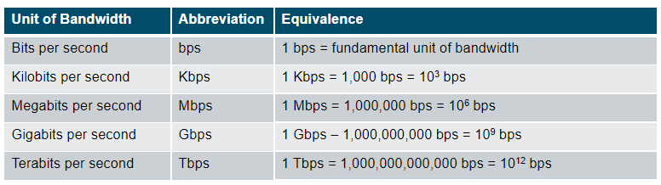
Physical Layer Characteristics Bandwidth
Bandwidth is the capacity at which a medium can carry data.
Digital bandwidth measures the amount of data that can flow from one place to another in a given amount of time; how many bits can be transmitted in a second.

Slide 9
Physical Layer Characteristics Bandwidth Terminology
Latency
Amount of time, including delays, for data to travel from one given point to another
Throughput
The measure of the transfer of bits across the media over a given period of time
Goodput
The measure of usable data transferred over a given period of time.
Goodput = Throughput - traffic overhead

Slide 10
Copper Cabling Characteristics of Copper Cabling
Copper cabling is the most common type of cabling used in networks today. It is inexpensive, easy to install, and has low resistance to electrical current flow.
Limitations:
Attenuation – the longer the electrical signals have to travel, the weaker they get.
The electrical signal is susceptible to interference from two sources, which can distort and corrupt the data signals (Electromagnetic Interference (EMI) and Radio Frequency Interference (RFI) and Crosstalk).
Mitigation:
Strict adherence to cable length limits will mitigate attenuation.
Some kinds of copper cable mitigate EMI and RFI by using metallic shielding and grounding.
Some kinds of copper cable mitigate crosstalk by twisting opposing circuit pair wires together.

Slide 11
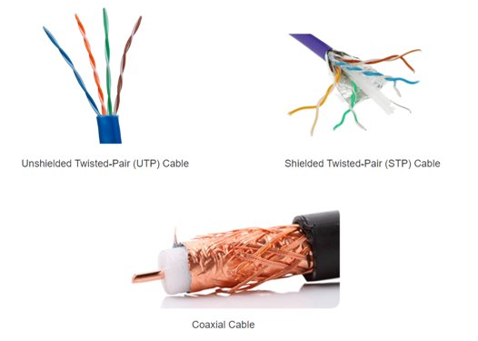
Copper Cabling Types of Copper Cabling

Slide 12
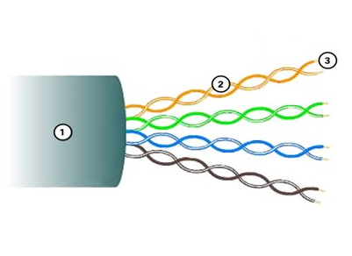
Copper Cabling Unshielded Twisted Pair (UTP)
UTP is the most common networking media.​
Terminated with RJ-45 connectors​
Interconnects hosts with intermediary network devices.​
Key Characteristics of UTP​
The outer jacket protects the copper wires from physical damage.​
Twisted pairs protect the signal from interference.​
Color-coded plastic insulation electrically isolates the wires from each other and identifies each pair.​

Slide 13
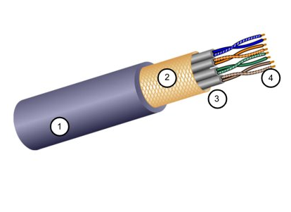
Copper Cabling Shielded Twisted Pair (STP)
Better noise protection than UTP​
More expensive than UTP​
Harder to install than UTP​
Terminated with RJ-45 connectors​
Interconnects hosts with intermediary network devices​
Key Characteristics of STP:
The outer jacket protects the copper wires from physical damage
Braided or foil shield provides EMI/RFI protection
Foil shield for each pair of wires provides EMI/RFI protection
Color-coded plastic insulation electrically isolates the wires from each other and identifies each pair

Slide 14
Copper Cabling Coaxial Cable
Consists of the following:
Outer cable jacket to prevent minor physical damage
A woven copper braid, or metallic foil, acts as the second wire in the circuit and as a shield for the inner conductor.
A layer of flexible plastic insulation.
A copper conductor is used to transmit the electronic signals.
There are different types of connectors used with coax cable.
Commonly used in the following situations:
Wireless installations - attach antennas to wireless devices
Cable internet installations - customer premises wiring

Slide 15
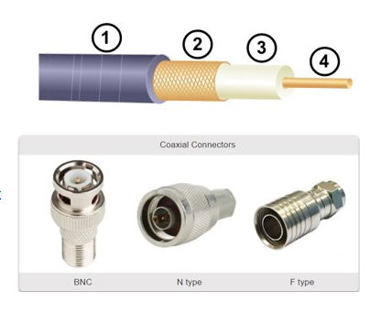
Copper Cabling Coaxial Cable

Slide 16
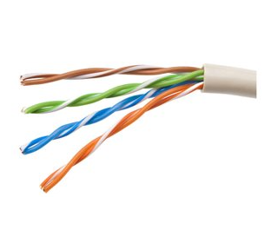
UTP Cabling Properties of UTP Cabling
UTP has four pairs of color-coded copper wires twisted together and encased in a flexible plastic sheath. No shielding is used. UTP relies on the following properties to limit crosstalk:
Cancellation - Each wire in a pair of wires uses opposite polarity. One wire is negative, the other wire is positive. They are twisted together and the magnetic fields effectively cancel each other and outside EMI/RFI.
Variation in twists per foot in each wire - Each wire is twisted a different amount, which helps prevent crosstalk amongst the wires in the cable.

Slide 17
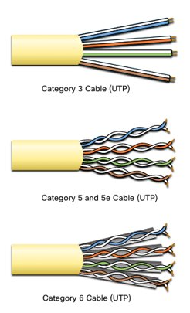
UTP Cabling UTP Cabling Standards and Connectors
Standards for UTP are established by the TIA/EIA. TIA/EIA-568 standardizes elements like:
Cable Types
Cable Lengths
Connectors
Cable Termination
Testing Methods
Electrical standards for copper cabling are established by the IEEE, which rates cable according to its performance. Examples include:
Category 3
Category 5 and 5e
Category 6

Slide 18
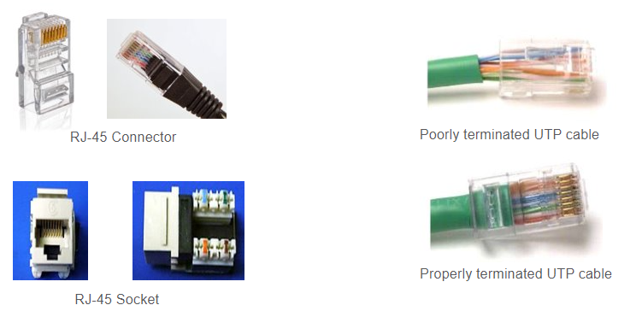
UTP Cabling UTP Cabling Standards and Connectors (Cont.)

Slide 19
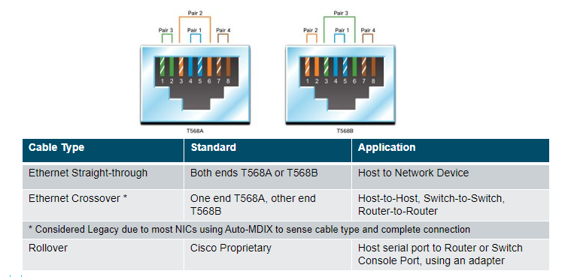
UTP Cabling Straight-through and Crossover UTP Cables

Slide 20
Fiber-Optic Cabling Properties of Fiber-Optic Cabling
Not as common as UTP because of the expense involved
Ideal for some networking scenarios
Transmits data over longer distances at higher bandwidth than any other networking media
Less susceptible to attenuation, and completely immune to EMI/RFI
Made of flexible, extremely thin strands of very pure glass
Uses a laser or LED to encode bits as pulses of light
The fiber-optic cable acts as a wave guide to transmit light between the two ends with minimal signal loss

Slide 21
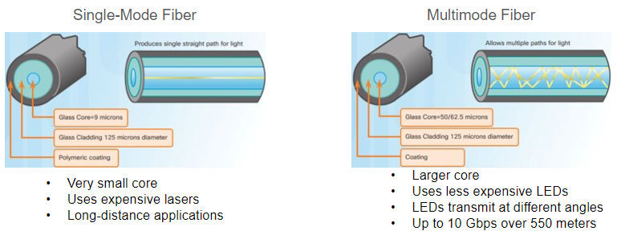
Fiber-Optic Cabling Types of Fiber Media
Dispersion refers to the spreading out of a light pulse over time. Increased dispersion means increased loss of signal strength. MMF has greater dispersion than SMF, with the maximum cable distance for MMF is 550 meters.​

Slide 22
Fiber-Optic Cabling Fiber-Optic Cabling Usage
Fiber-optic cabling is now being used in four types of industry:
Enterprise Networks - Used for backbone cabling applications and interconnecting infrastructure devices
Fiber-to-the-Home (FTTH) - Used to provide always-on broadband services to homes and small businesses
Long-Haul Networks - Used by service providers to connect countries and cities
Submarine Cable Networks - Used to provide reliable high-speed, high-capacity solutions capable of surviving in harsh undersea environments at up to transoceanic distances.

Slide 23
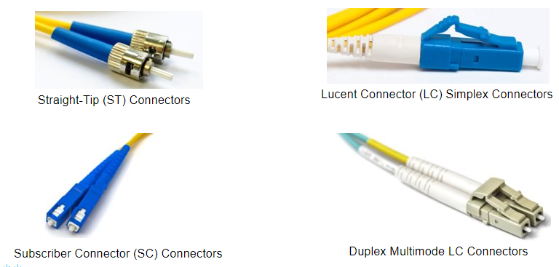
Fiber-Optic Cabling Fiber-Optic Connectors

Slide 24
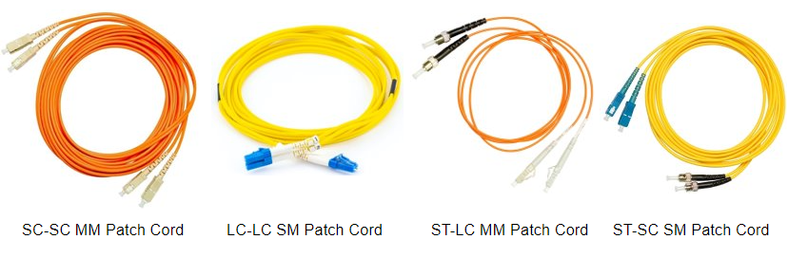
Fiber-Optic Cabling Fiber Patch Cords
A yellow jacket is for single-mode fiber cables and orange (or aqua) for multimode fiber cables.​

Slide 25
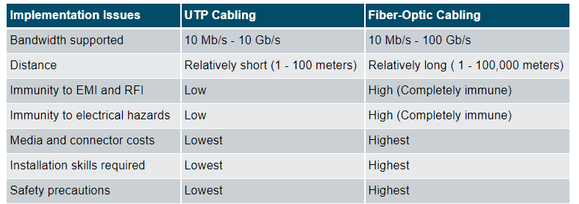
Fiber-Optic Cabling Fiber versus Copper
Optical fiber is primarily used as backbone cabling for high-traffic, point-to-point connections between data distribution facilities and for the interconnection of buildings in multi-building campuses.

Slide 26
Wireless Media Properties of Wireless Media
It carries electromagnetic signals representing binary digits using radio or microwave frequencies. This provides the greatest mobility option. Wireless connection numbers continue to increase.
Some of the limitations of wireless:
Coverage area - Effective coverage can be significantly impacted by the physical characteristics of the deployment location.
Interference - Wireless is susceptible to interference and can be disrupted by many common devices.
Security - Wireless communication coverage requires no access to a physical strand of media, so anyone can gain access to the transmission.
Shared medium - WLANs operate in half-duplex, which means only one device can send or receive at a time. Many users accessing the WLAN simultaneously results in reduced bandwidth for each user.

Slide 27
Wireless Media Types of Wireless Media
The IEEE and telecommunications industry standards for wireless data communications
cover both the data link and physical layers. In each of these standards, physical layer
specifications dictate:
Data to radio signal encoding methods
Frequency and power of transmission
Signal reception and decoding requirements
Antenna design and construction
Wireless Standards:
Wi-Fi (IEEE 802.11) - Wireless LAN (WLAN) technology
Bluetooth (IEEE 802.15) - Wireless Personal Area network (WPAN) standard
WiMAX (IEEE 802.16) - Uses a point-to-multipoint topology to provide broadband wireless access
Zigbee (IEEE 802.15.4) - Low data-rate, low power-consumption communications, primarily for Internet of Things (IoT) applications

Slide 28
Wireless Media Wireless LAN
In general, a Wireless LAN (WLAN) requires the following devices:
Wireless Access Point (AP) - Concentrate wireless signals from users and connect to the existing copper-based network infrastructure
Wireless NIC Adapters - Provide wireless communications capability to network hosts
There are a number of WLAN standards. When purchasing WLAN equipment, ensure compatibility, and interoperability.
Network Administrators must develop and apply stringent security policies and processes to protect WLANs from unauthorized access and damage.

